Slide 1

RadioInstigator
Signals Intelligence Platform

Slide 2
Who am I?
Josh Conway (CrankyLinuxUser)
FCC Amateur radio: KC9JEF Facial Recog for your ‘Con (CPU bound, no gpu, no internet) https://hackaday.com/2015/03/04/face-recognition-for-your-next-con/ Multisite Home/Office/Hackerspace Automation
https://hackaday.io/project/12985-multisite-homeofficehackerspace-automation
Thalmic Labs(North) Shuts Down Free Developer Access Update: It’s Back Again https://hackaday.com/2014/11/18/thalmic-labs-shuts-down-free-developer-access/https://hackaday.com/2014/11/18/thalmic-labs-shuts-down-free-developer-access/

Slide 3
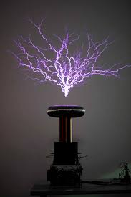
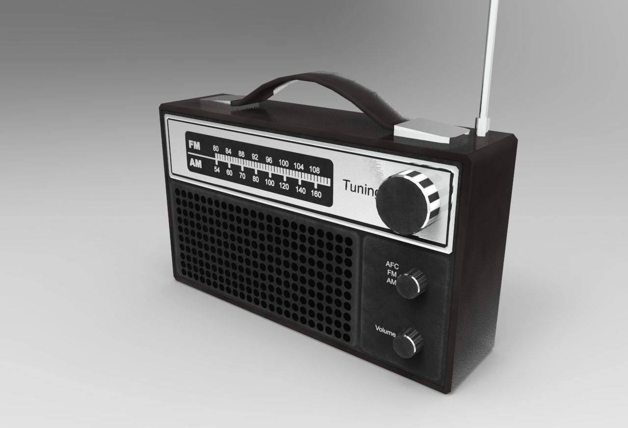
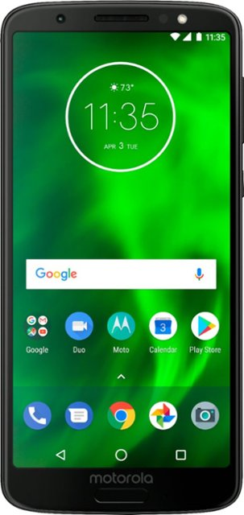
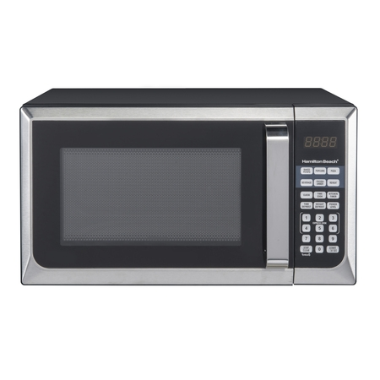

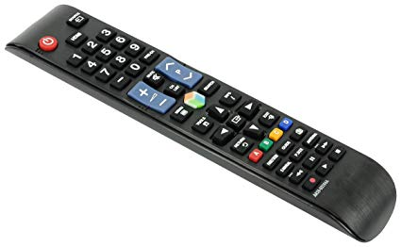
What is this “Radio” thing, anyways?

Slide 4
They all are!
Definition (noun): The transmission and reception of electromagnetic waves of radio frequency, especially those carrying sound messages.
Definition (verb): communicate or send a message by radio.

Slide 5
Signals Intelligence
Signals intelligence (SIGINT) is intelligence-gathering by interception of signals, whether communications between people (communications intelligence—abbreviated to COMINT) or from electronic signals not directly used in communication (electronic intelligence—abbreviated to ELINT).
-- Wikipedia
BUT WHY DO WE CARE???

Slide 6

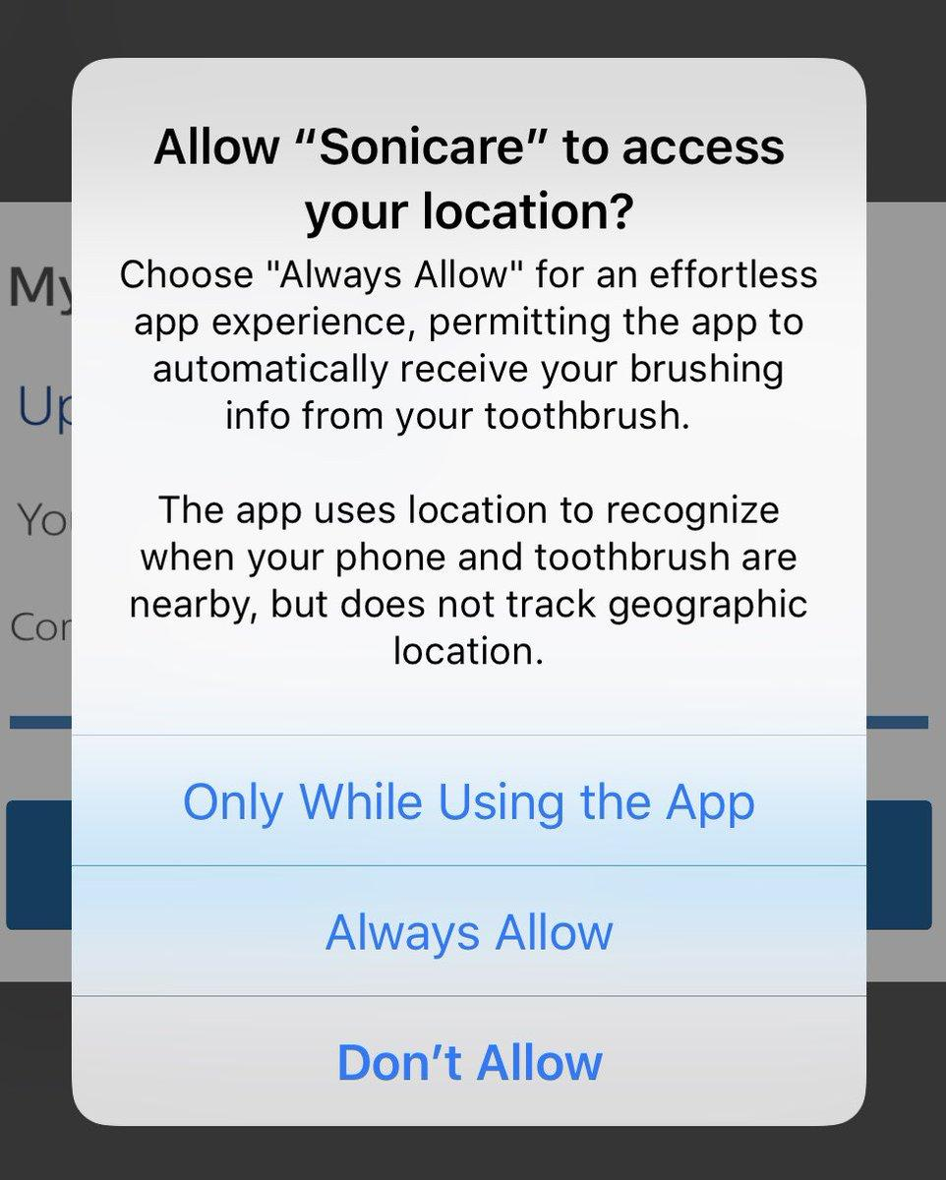


Common household things… Right?

Slide 7
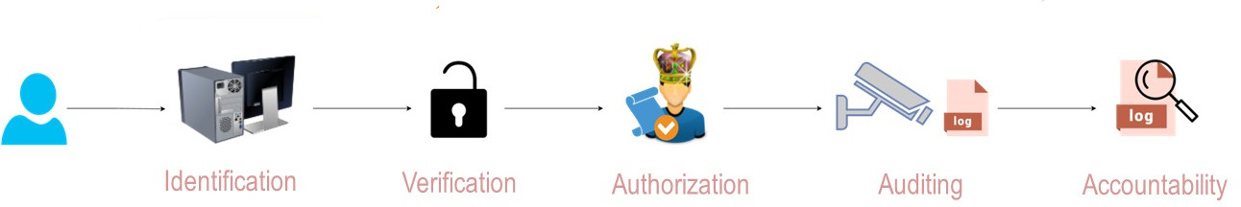
Security? Not if we can get away without it!
How many of these are implemented on radios you own?
Are they secure?
Are you sure???

Slide 8
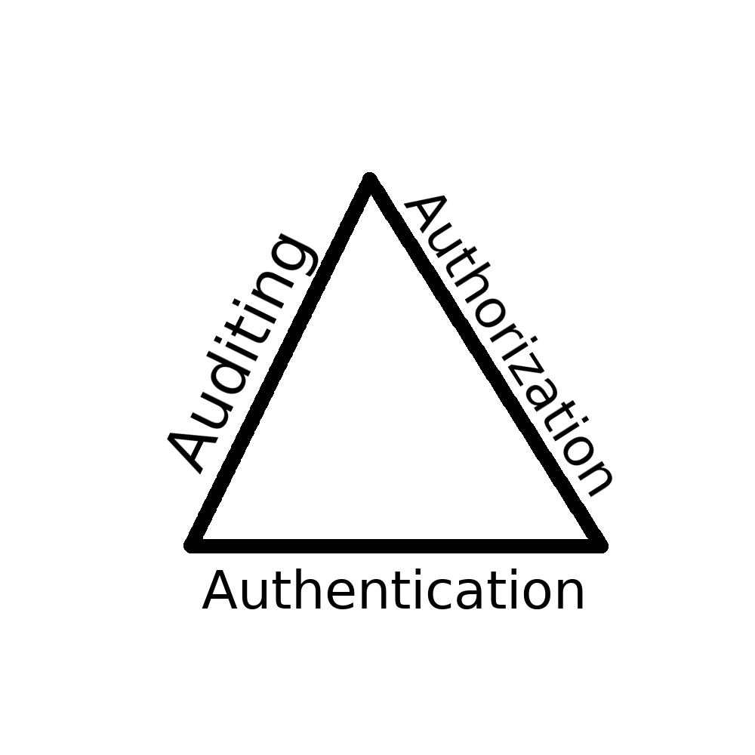



Why we care
Unknown
hardware
Unencrypted

Slide 9
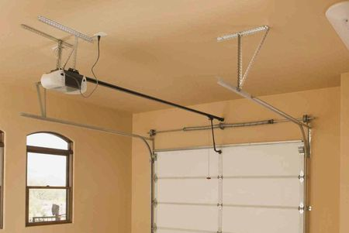

Awareness is Key … At home

Slide 10

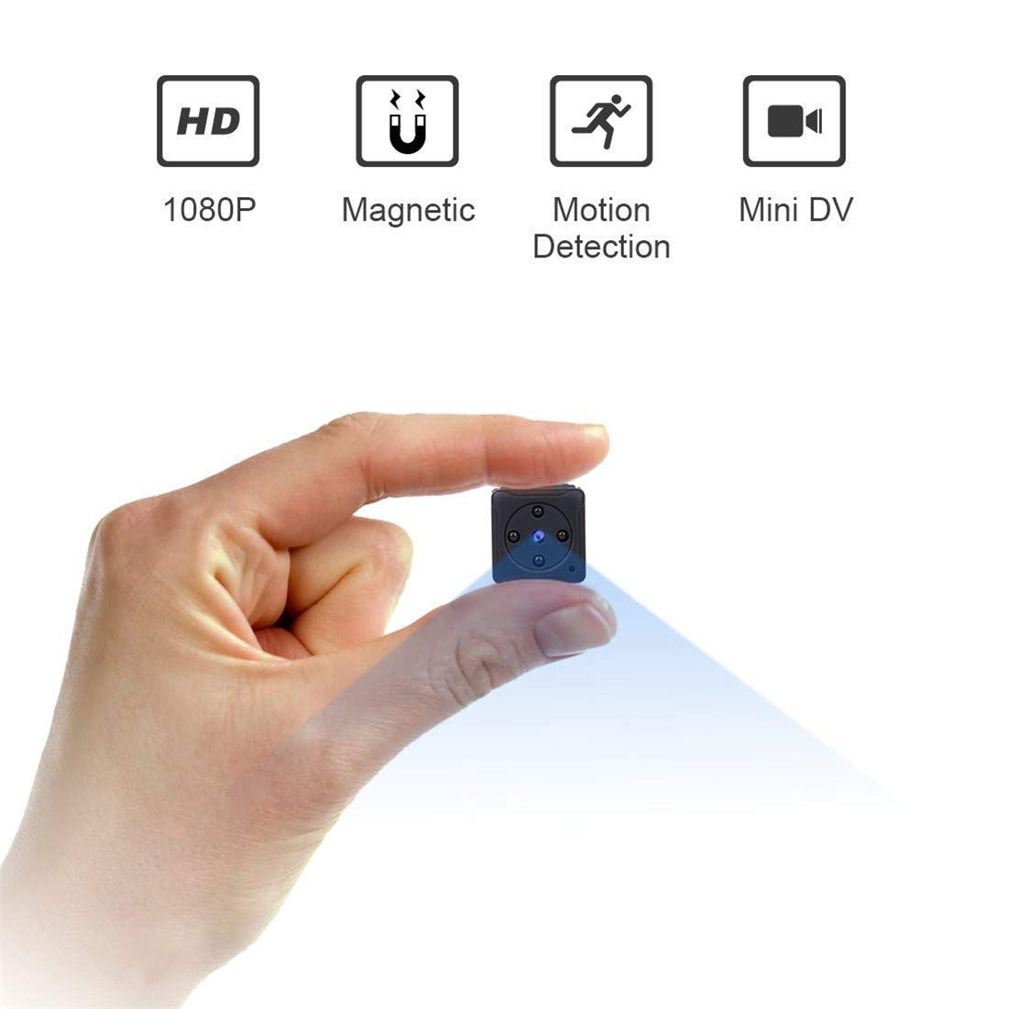

Awareness is Key … On Vacation
Spycam $37 , Amazon
USB cell spy *cable* $12

Slide 11
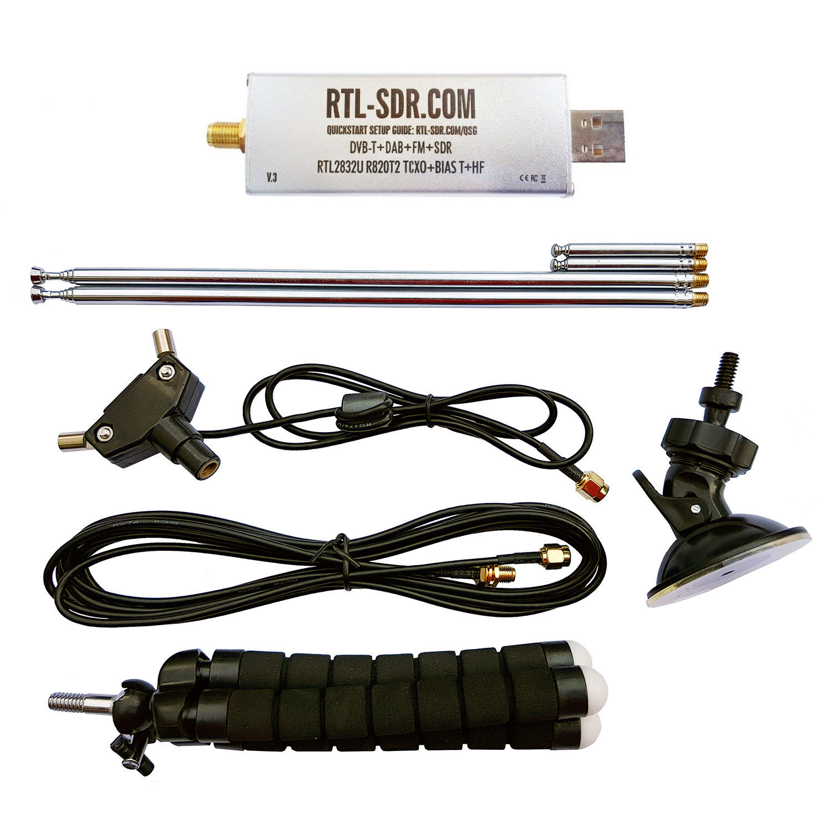
Review of Platforms
RTL-SDR - $20 (avg)
Originally a TV tuner card for Asian TV
Can Receive only 20 MHz-1.7GHz

Slide 12
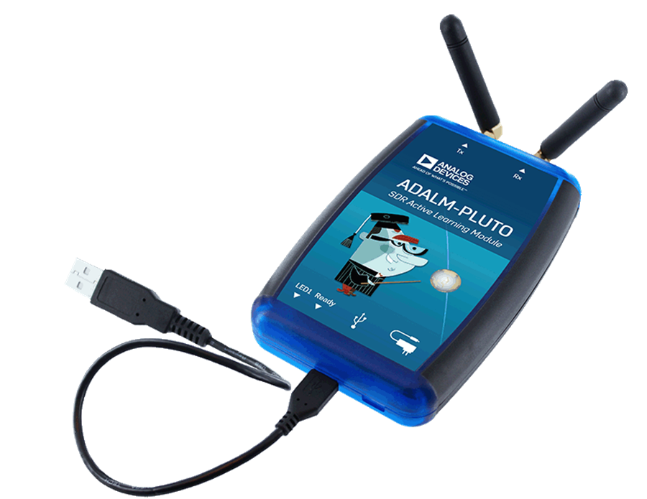
Review of Platforms
ADALM-PLUTO - $100
Dedicated Transmit/Receive Software Radio
Transmit/Receive 70MHz-6GHz

Slide 13
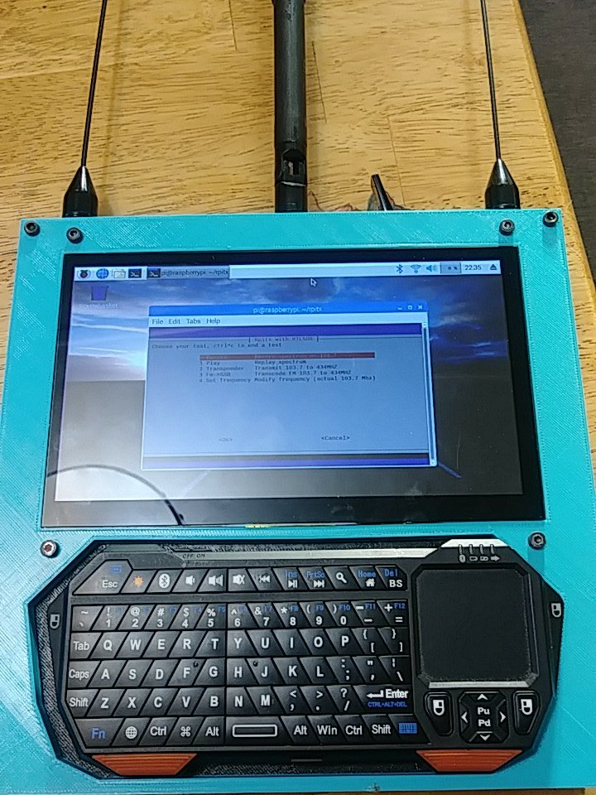
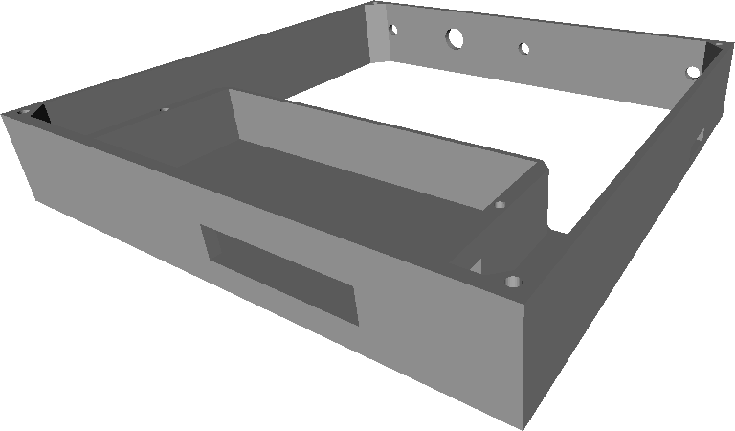
My Platform - A $150 Signals Intelligence Tablet
Raspberry Pi 3 B+
HDMI Touchscreen
RTL-SDR
Keyboard
Cool prints!

Slide 14


Software Whisperer (OS, Libraries)
RPITX Library RTL_SDR Libraries

Slide 15
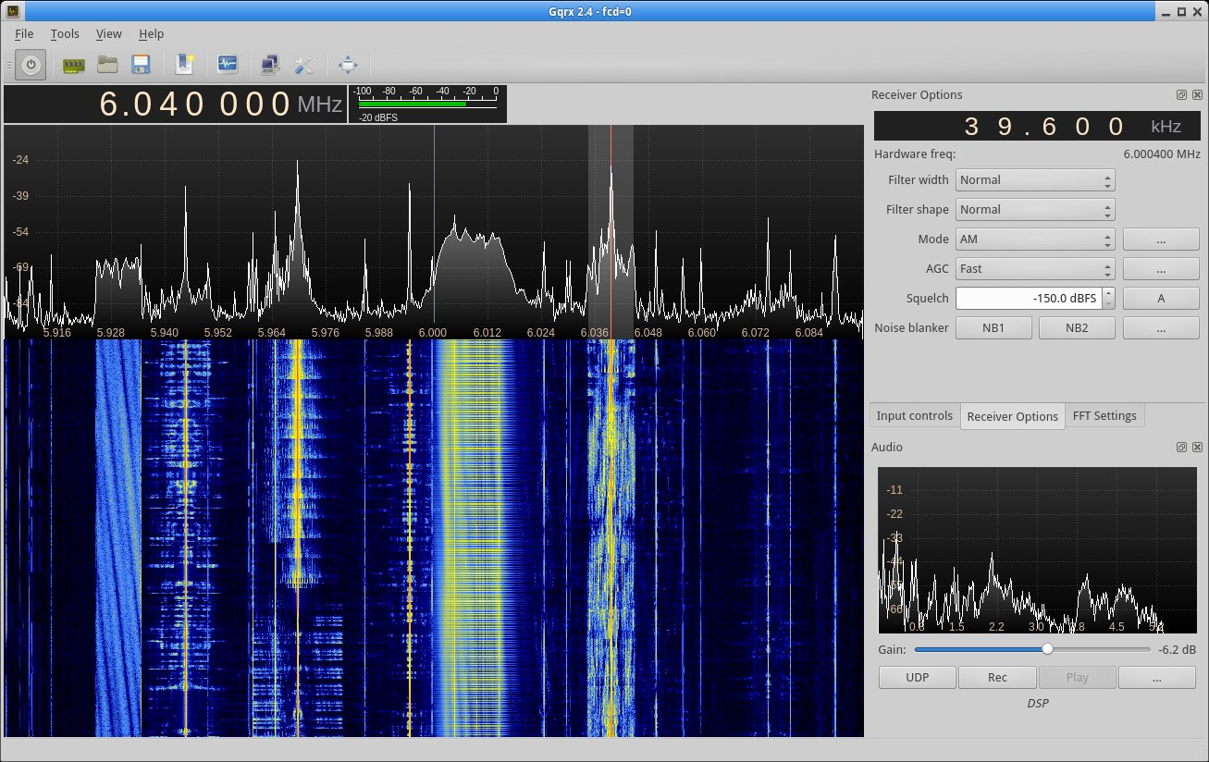
Software / GQRX

Slide 16
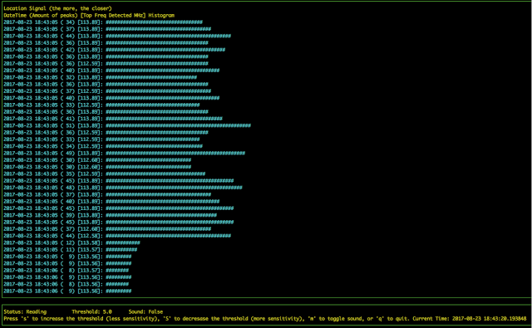
Salamandra - Spy Microphone Detector

Slide 17
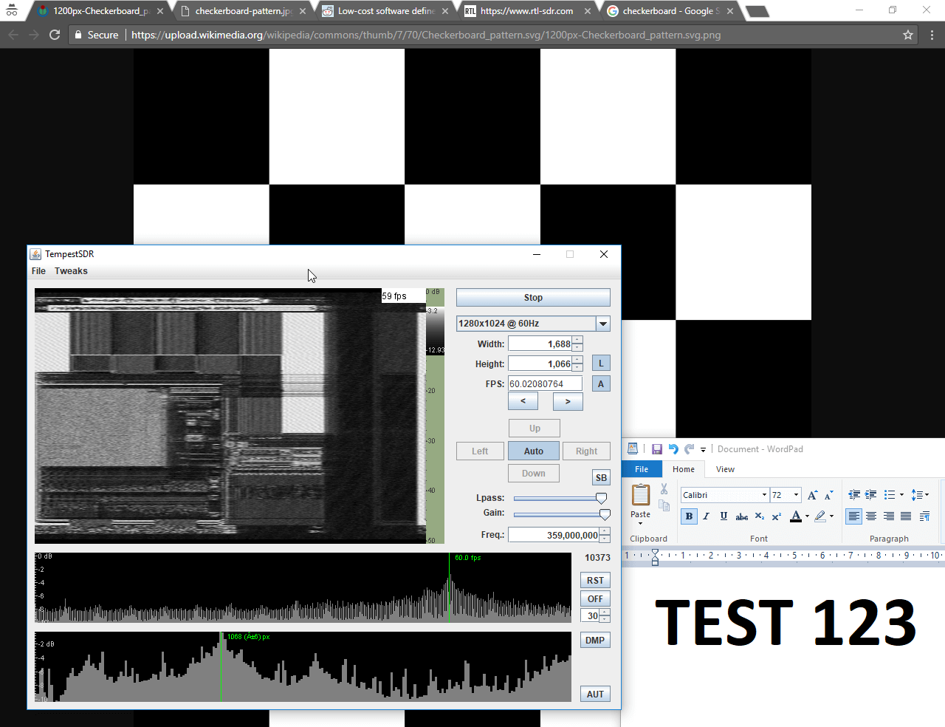
TempestSDR - Every Monitor is Wireless

Slide 18
Demotime….

Slide 19

You want to build one?

Slide 20
RadioInstigator
Signals Intelligence Platform
Josh Conway

